Slide 1
HOW TO BE SATURATED WITH THE WORD OF GOD
FIVE SUGGESTIONS
WE NEED TO FEED ON THE WORD TO BE HEALTHY CHRISTIANS.

Slide 2
I PETER 2:2,3 AS NEW BORN BABES, DESIRE THE SINCERE MILK OF THE WORD, THAT YOU MAY GROW THERE BY
IF SO BE YOU HAVE TASTED THAT THE LORD IS GRACIOUS.
MY GRANDADS SNAKE STORY.
SPURGEON—”NO BIBLE, NO BREAKFAST”

Slide 3
JOB 23:12
I HAVE ESTEEMED THE WORDS OF HIS MOUTH MORE THAN MY NECESSARY FOOD.

Slide 4
REVELATION 1:3 KJV
BLESSED IS HE THAT READETH, AND THEY THAT HEAR THE WORDS OF THIS PR0PHECY, AND KEEP THOSE THINGS WHICH ARE WRITTEN THEREIN….

Slide 5
HEARING AND READING

Slide 6
WE NEED TO STUDY THE WORD TO BE INTELLIGENT CHRISTIANS
II TIMOTHY 2:15 KJV”
“STUDY TO SHOW THYSELF APPROVED UNTO GOD, A WORKMAN THAT NEEDETH NOT TO BE ASHAMED, RIGHTLY DIVIDING THE WORD OF TRUTH,”

Slide 7
DEFINE A GOOD BIBLE STUDY
ORIGINAL INVESTIGATION----- UN- MARKED BIBLE
WRITTEN REPODUCTION-----PEN AND PAPER
PERSONAL APPLICATION
PROGRESSIVE—TO COVER MUCH OF THE BIBLE
PASS-ON-ABLE
HOW TO MASTER THE BIBLE
ILLUSTRATION BOOK OF JOHN.

Slide 8
WE NEED TOMEMORIZE THE WORD TO BE SKILLFUL.
PROVERBS 7:3 KJV “BIND THEM UPON THY FINGERS; WRITE THEM UPON THE TABLE OF THINE HEART.”
PSALM 119:11 “THY WORD HAVE I HID IN MY HEART, THAT I MIGHT NOT SIN AGAINST THEE,”
WANT TO BE A WINNER???????
ILLUSTRATE JESSE MILLER—PUEBLO CAPTAIN

Slide 9
PSALM 1:2
BUT HIS DELIGHT IS IN THE LAWOF THE LORD,A ND ON HIS LAW HE MEDITATES DAY AND NIGHT.
HE IS LIKE A TREE PLANTED BY STREAMS OF WATER,
WHICH YIELDS ITS FRUIT IN SEASON AND WHOSE LEAF DOES NOT WITHER.
WHATEVER HE DOES PROSPERS.”

Slide 10
WE NEED TO MEDITATE IN THE WORD TO BE FRUITFUL

Slide 11
JOHN 15; ph.
“IT IS THE MAN WHO SHARES MY LIFE AND WHOSE LIFE I SHARE WHO PROVES FRUITFUL.”
MEDITATION IS SHARING HIS LIFE BY USING THE MIND TAPROOT.

Slide 12
JEREMIAH 17:8
“HE WILL BE LIKE A TREE PLANTED BY THE WATER THAT SENDS OUT ITS ROOTS BY THE STREAM.
IT DOES NOT FEAR WHEN HEAT COMES;
IT’S LEAVES ARE ALWAYS GREEN.
IT HAS NO WORRIES IN A YEAR OF DROUGHT AND NEVER FAILS TO BEAR FRUIT”.

Slide 13
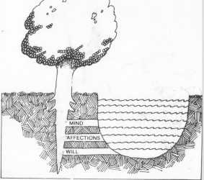

Slide 14
HOW ABOUT DAY AND NIGHT MEDITATION?

Slide 15
CONSCIOUS AND SUB-CONSCIOUS
DURING WAKING HOURS THE CONSCIOUS MIND SENDS LIFE SUSTAINING SIGNALS TO HEART, LUNGS, ETC
WHEN SLEEP BEGINS THE CONSCIOUS MIND TRANSFERS THAT RESPONBILITY TO THE SUB CONSCIOUS. THE CONSCIOUS ALSO DUMPS THE THOUGHT OCCUPYING IT. OFTEN THIS IS AN UNSOLVED PROBLEM.

Slide 16
“JERK” ILLUSTRATION

Slide 17
THE SUB CONSIOUS JOB DESCRIPTION
TO RESTORE THE BODY AND MIND TO THEIR HIGHEST PEAK OF EFFICIENCY BY SLOWING THE HEART RATE AND CAUSING CERTAIN RESTORING HARMONES TO BE RELEASED.
WHAT IF THE LAST WAKING THOUGHT IS AN UNSOLVED PROBLEM?

Slide 18
THE STRUGGLE
THE CONSCIOUS AND SUBCONSCIOUS PASS THE PROBLEM BACK AND FORTH AND WE MAY WAKE UP IN THE MORNING
MORE TIRED THAN WHEN WE WENT TO BED.

Slide 19
WHAT IF THE LAST WAKING THOUGHT IS SOMETHING FROM THE WORD OF GOD?
PROVERBS 6:22 HAS A CLUE:
“WHEN YOU WALK THEY WILL GUIDE YOU; WHEN YOU SLEEP THEY WILL WATCH OVER YOU;WHEN YOU AWAKE THEY WILL SPEAK TO YOU.”
DET AND GWLW
TESTIMONIES

Slide 20
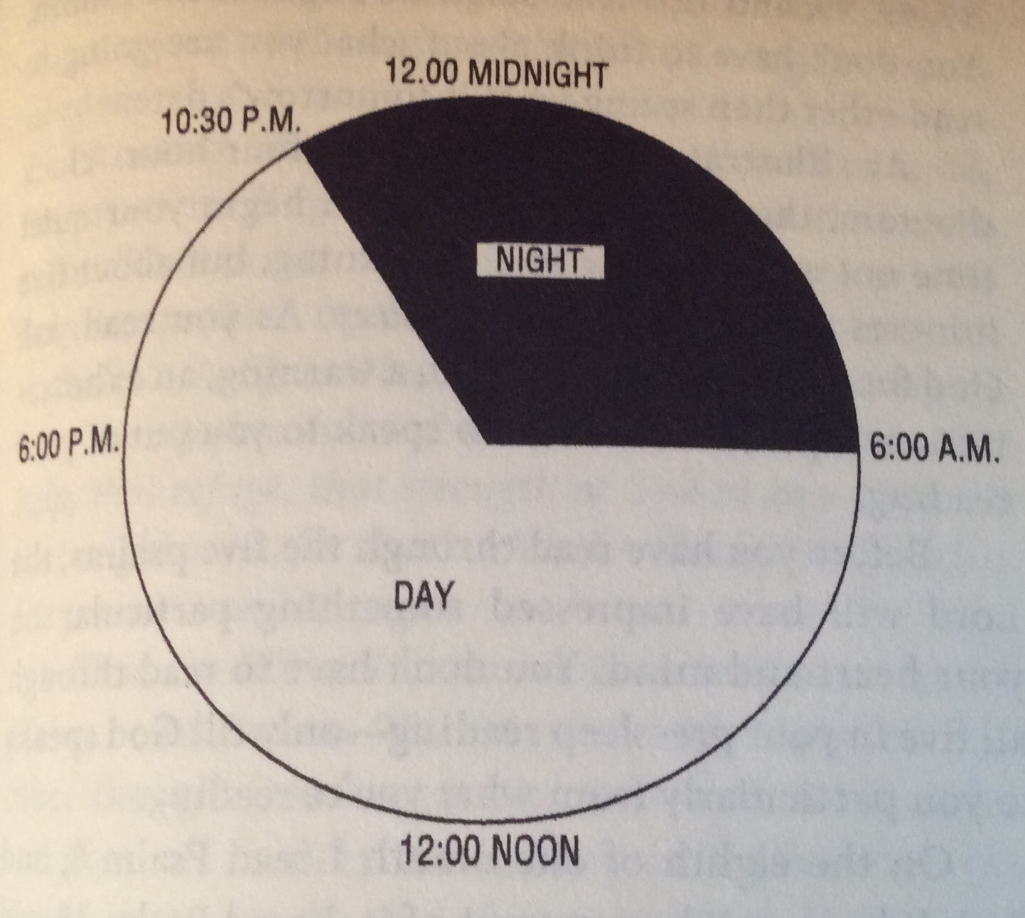

Slide 21
APPLYING THE WORD
WE NEED TO APPLY THE WORD TO BE
OBEDIENT CHRISTIANS.
JAMES 1:22
ILLUSTRATION OF MIRROR

Slide 22
SUMMARY
WE NEED TO FEED ON THE WORD TO BE HEALHY CRISTIANS.
WE NEED TO STUDY THE WORD TO BE INTELLIGENT CRISTIANS.
WE NEED TO MEMORIZE THE WORD TO BE SKILLFULCHRISIANS.
WE NEED TO MEDITATE IN THE WORD TO BE FRUITFUL CHRISIANS.
WE NEED TO APPLY THE WORD TO BE OBEDIENT CHISTIANS.

